Slide 1

Demystifying Neural Networks: Part 2
More
Brandon Wen
December 19, 2019

Slide 2

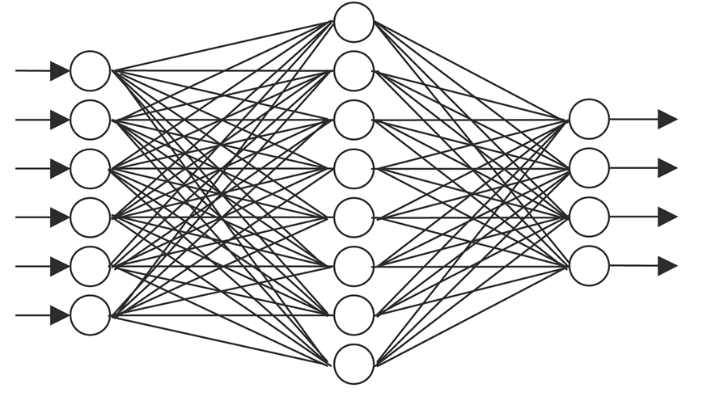

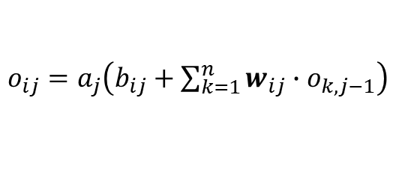
A quick review
This movie was $&@^#% garbage!
8
Bad
Input
$o_{ij}=a_{j}\left(b_{ij}+\sum_{k=1}^{n}{w_{ij}{∙o}_{k,j−1}}\right)$
Output
IMDb
Movie Reviews Dataset

Slide 3
Some NLP basics
Review: “A brilliant and timeless masterpiece.”
Define vocabulary set
(Represent each word with a number)
Bag-of-words Representation
We can augment the list of features by using n-grams in addition to individual words.
Notice that the ordering of the words don’t matter.
Also notice that the vast majority of the features will be 0’s.
Special token for unknown words
 | abandon | ability | … | brilliant | … | timeless | … | zulu
Review 1 | 0 | 0 |  | 1 |  | 1 |  | 0
Review 2 | 0 | 3 |  | 0 |  | 2 |  | 0
Review 3 | 0 | 0 |  | 1 |  | 0 |  | 0
…
Index | Word
0 | <UNK>
1 | a
2 | abandon
3 | ability
…
1143 | brilliant
…
…
9035 | timeless
…
10000 | zulu
Each word is mapped to an integer
Can we improve this?

Slide 4
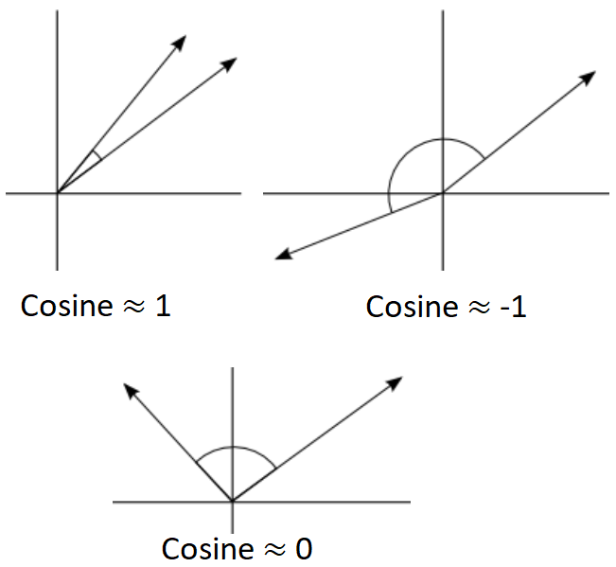
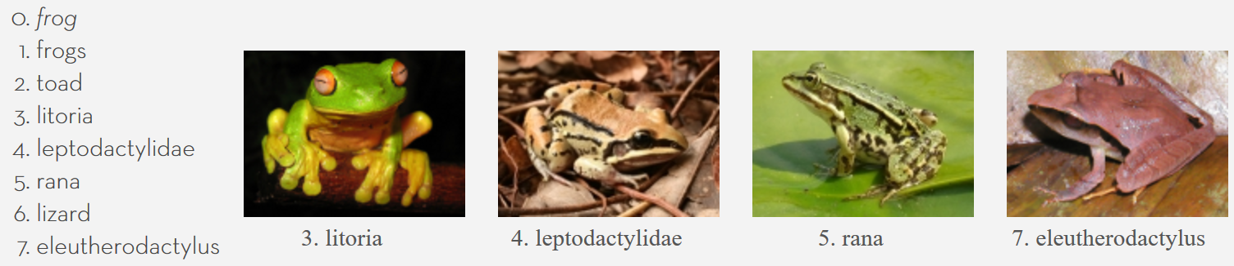
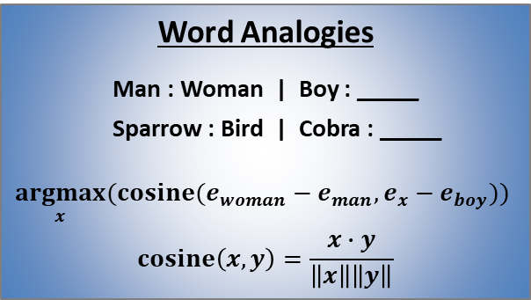
Word embeddings: vectorized representation of word meanings
Embedding Matrix (M x N)
Word Analogies
Man : Woman | Boy : _____
Sparrow : Bird | Cobra : _____
$$\underset{x}{argmax}{(cosine(e_{woman}−e_{man},e_{x}−e_{boy})) }$$
$$cosine\left(x, y\right)=\frac{x∙y}{\left\|x\right\|\left\|y\right\|}$$
king | < |  | , |  | , |  | , |  |  | >
queen | < |  | , |  | , |  | , |  |  | >
boy | < |  | , |  | , |  | , |  |  | >
girl | < |  | , |  | , |  | , |  |  | >
apple | < |  | , |  | , |  | , |  |  | >
… | < |  |  |  |  |  |  |  |  | >
Female
-0.96
0.98
-0.98
1.00
0.08
Royalty
0.99
0.98
-0.85
-0.85
-0.27
Youthful
-0.80
-0.89
0.95
0.85
0.01
…
Edible
-0.92
-0.91
-0.95
-0.96
0.68
Vocabulary size M
N-dimensional embedding vectors
Learning word embeddings from context
Word2Vec skip-gram model https://arxiv.org/pdf/1301.3781.pdf
GloVe pre-trained word embeddings
Pre-trained word embedding vectors made open source by the Stanford NLP Group
Trained using the 2014 English Wikipedia dump
400K vocabulary size
Several versions: 50d, 100d, 200d, or 300d vectors
Nearest Neighbors

Slide 5
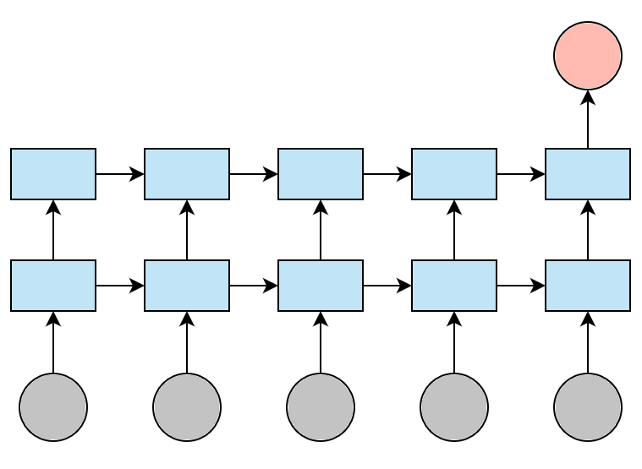
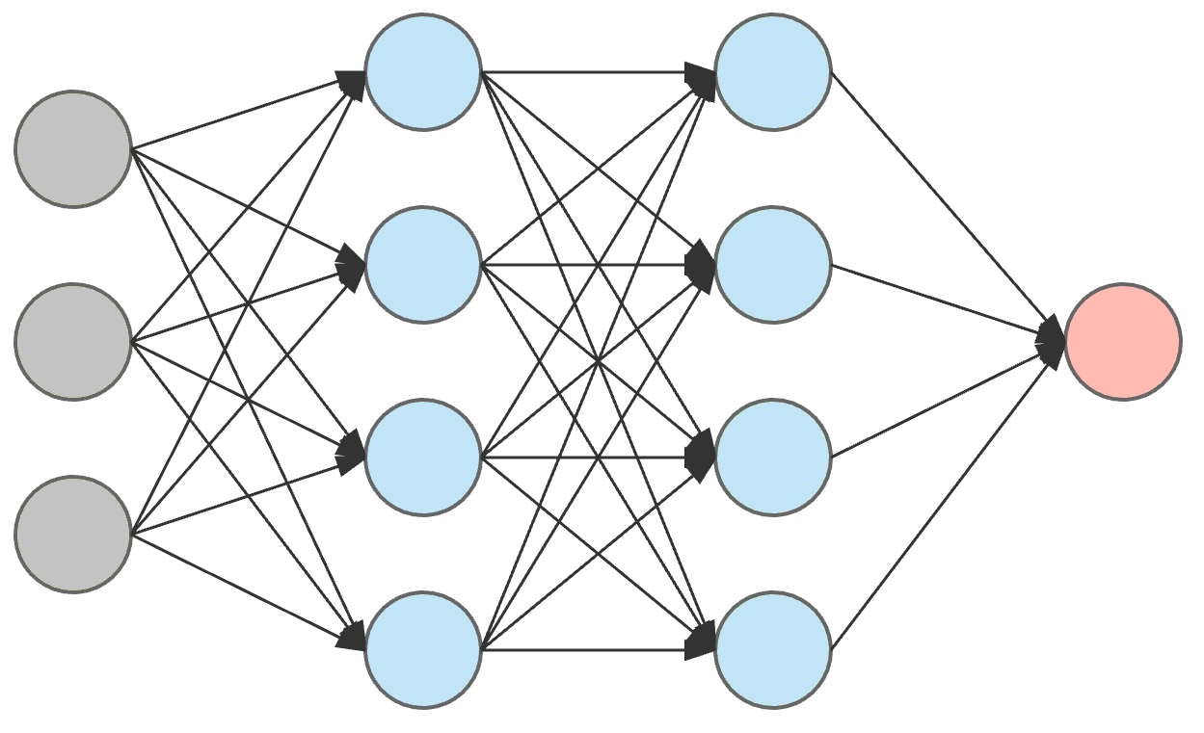
Recurrent neural networks - Introduction
Output
Recurrent (hidden) layers
A brilliant and timeless masterpiece
Note:
All recurrent layers must be of the same size, the input size.
Information only travels in one direction (left to right).

Slide 6
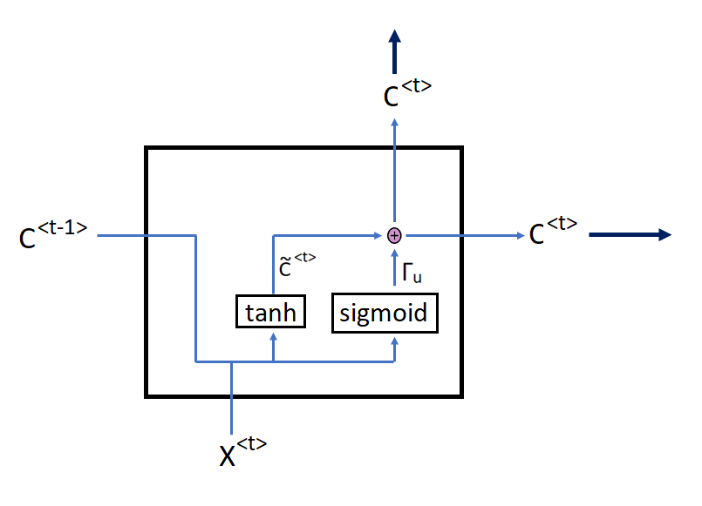

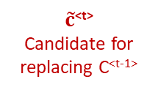
GRUs:
Gated Recurrent Units
$\tilde{c}$^{<t>}
Candidate for replacing C^{<t-1>}
C^{<t>}
New calculated memory value (output)
C^{<t-1>}
Memory value from previous time step
Γ_{u}
Update gate: decides whether or not to replace old memory value
X^{<t>}
New sequential input at current time step
If you really want the headache:
$${\tilde{c}}^{<t>}=\tanh\left(W_{cc}∙c^{<t−1>}+W_{cx}∙x^{<t>}+b_{c}\right)$$
$$Γ_{u}=σ\left(W_{uc}∙c^{<t−1>}+W_{ux}∙x^{<t>}+b_{u}\right)$$
$$c^{<t>}=Γ_{u}∙{\tilde{c}}^{<t>}+(1−Γ_{u})∙c^{<t−1>}$$

Slide 7
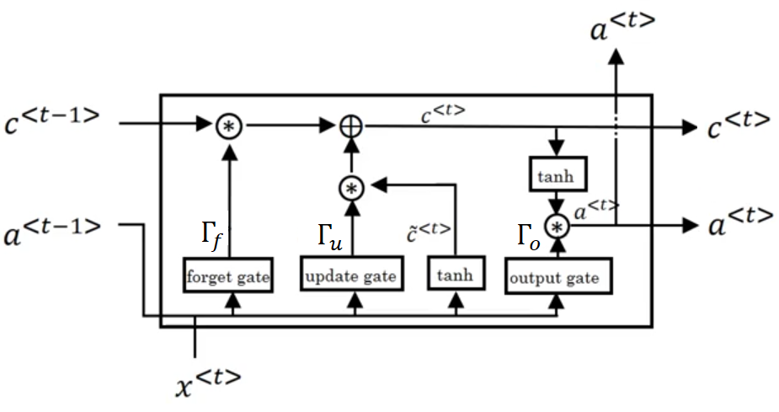
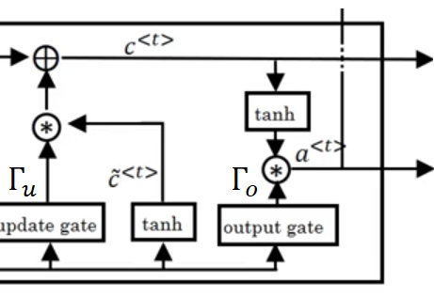
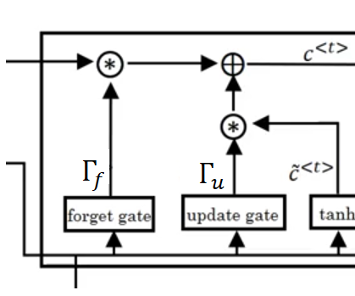



LSTMs: Long-Short Term Memory Units
Separate long-term and short-term memory outputs
A bunch more gates
Gates of a LSTM Cell:
Γ_{u} (Update): Decides how much of the candidate memory value is worth keeping.
Γ_{f} (Forget): Decides which pieces of information from the long-term memory state is safe to forget.
Γ_{o} (Output): Decides which pieces of information should be output as the short-term memory value to the next LSTM cell.
More headaches…
$${\tilde{c}}^{<t>}=\tanh\left(W_{ca}∙a^{<t−1>}+W_{cx}∙x^{<t>}+b_{c}\right)$$
$$Γ_{u}=σ\left(W_{ua}∙a^{<t−1>}+W_{ux}∙x^{<t>}+b_{u}\right)$$
$$Γ_{f}=σ\left(W_{fa}∙a^{<t−1>}+W_{fx}∙x^{<t>}+b_{f}\right)$$
$$Γ_{o}=σ\left(W_{oa}∙a^{<t−1>}+W_{ox}∙x^{<t>}+b_{o}\right)$$
$$c^{<t>}=Γ_{u}∙{\tilde{c}}^{<t>}+Γ_{f}∙c^{<t−1>}$$
$$a^{<t>}=Γ_{o}∙\tanh\left(c^{<t>}\right)$$

Slide 8
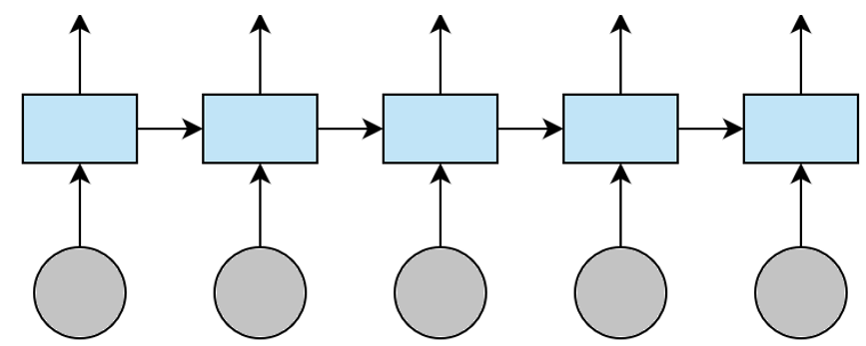
Bidirectional recurrent layers
Forward Pass
Backward Pass

Slide 9
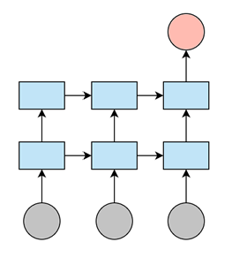
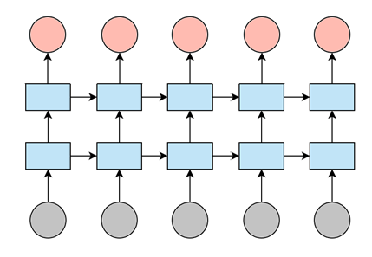
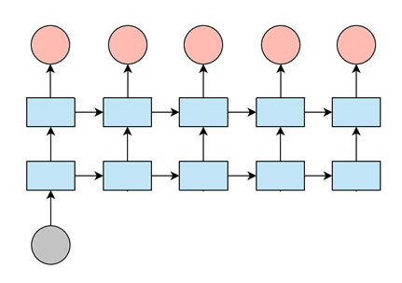
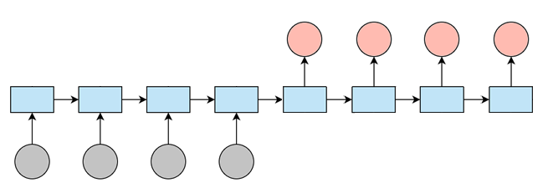
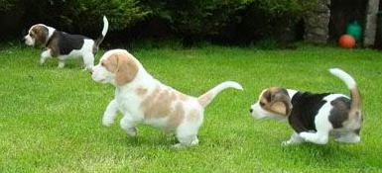
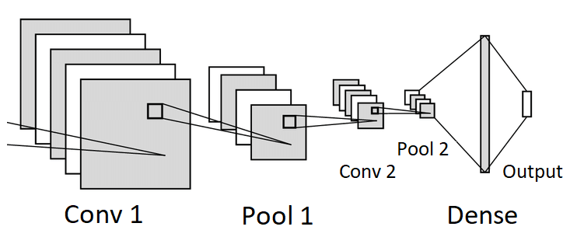
Types of recurrent neural networks
Many to One
Sentiment Analysis
Many to Many
Named Entity Recognition
One to Many
Image Captioning
1
0
1
1
1
0
Dogs playing in the grass
A great film
The New York Times reported…
Sequence to Sequence
Neural Machine Translation
J’ adore ce film!
Encoding
Decoding
I love this movie!

